Slide 1
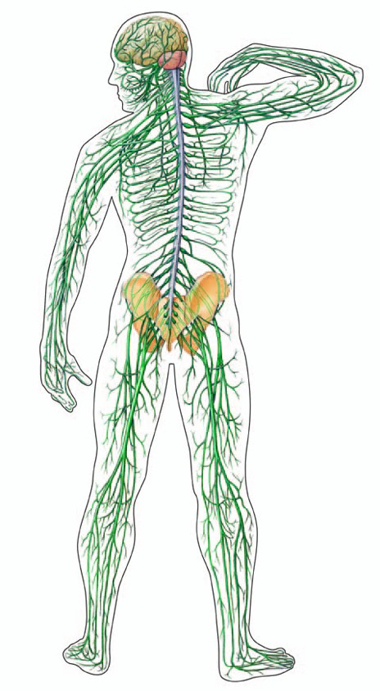
Neurological Disorders Lesson 2.2
How do our neurons signal electrically?
Electrical Signal

Slide 2
Do Now:
Ethan needs to have a cavity filled. Before his doctor begins drilling, she gives him Novocain to prevent pain.
How do you think Novocain works???
Novocain stops our neurons from signaling electrically.
But how do our neurons signal electrically???

Slide 3
Neurons Send Signals
Electrical Signal
Electrical Signal
Electrical Signal
Chemical
Signal
Chemical
Signal
Chemically via synapses
Electrically via axons

Slide 4
The Axon’s Electrical Signal: The Action Potential
Electrical Signal
Axons signal electrically in a process called the Action Potential.

Slide 5
Before we model the Action Potential, let’s review: Diffusion
?

Slide 6
Diffusion of Sodium Ions (Na⁺)
Na⁺
Na⁺
Na⁺
Na⁺
Na⁺
Na⁺
Na⁺
Na⁺
Na⁺
Na⁺
?
Na⁺
Na⁺
Na⁺
Na⁺
Na⁺
Na⁺
Na⁺
Na⁺

Slide 7
Before we model the Action Potential, let’s review: The Cell Membrane

Slide 8
The Cell Membrane
Why would Na+ want to move?
Na⁺
Na⁺
Na⁺
Closed
Na⁺ channel
Na⁺
Open
Na⁺ channel
What causes the Na⁺ channels to open?
Na⁺ channels open at Threshold.

Slide 9
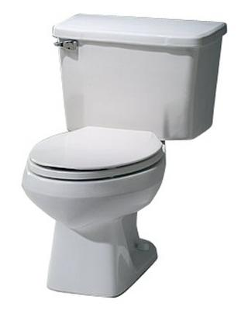
Before we model the Action Potential, let’s review: Threshold
How do you flush a toilet?
What if you just gently jiggle the handle? Will the toilet flush?
Can you stop a toilet from flushing after it’s started to flush?

Slide 10
Getting to Threshold
Electrical Signal
When a neuron receives signals from another neuron it may reach threshold.
If threshold is reached, Na⁺ channels open.

Slide 11
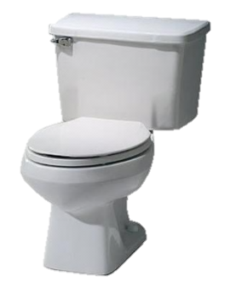
Getting to Threshold
Flush
Flush
Flush
Signal from another neuron

Slide 12
Modeling the Action Potential
Bean = Na⁺ ion
Outside
Closed channel
Open channel
Inside
Toothpick = Na⁺ ion channel

Slide 13
Model of the Action Potential
Na⁺
Na⁺
Na⁺
Na⁺
Na⁺
Na⁺
Na⁺
Signal from another neuron
Na⁺
Na⁺
Na⁺
Na⁺
Na⁺
Action Potential
Based on the principle of diffusion, where will the Na+ go once the Na+ channels open?
It will enter the axon, because it is a lower concentration inside the axon
Action Potential

Slide 14
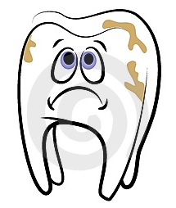
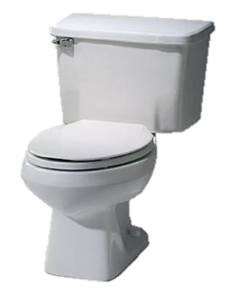
How does Novocain work?
It plugs the toilets!
Out of Order
Out of Order
Out of Order
Pain Signal

Slide 15
How does Novocain work?
What happens if the Na⁺ channels can’t open?
Novocain
Novocain
Novocain
Pain Signal
No Signal
The axon can’t send Action Potentials.
Meaning you can’t feel pain!

